Slide 1
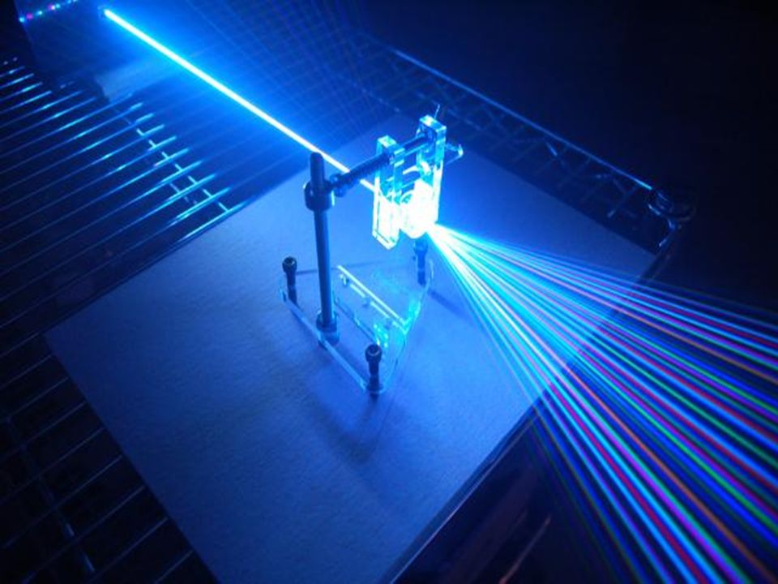
PHYS& 223 – Engineering Physics III Spring 2021 Final Presentation – Refractive Indices of Unknown Materials
Johnathan Chivington – North Seattle College – BS, Physics
Sandesh Rai – North Seattle College – BS, CS
Vasyl Kepynach – North Seattle College – BS, CS

Slide 2
Goals
Experimental Goals
Design and execute three identical refraction experiments.
Test hypothesis that two blocks of different unknown materials have measurably different refraction indices.
Use the results to determine a putative identity of each block’s physical composition.
Experimental Setup & Contributions
Johnathan will perform a refraction experiment using one provided block from kit (a), of an unknown material.
Vasyl will perform a second identical experiment with an unknown block from his matching kit (a), of the same material.
Sandesh will perform a third identical experiment with a block from kit (b), of a different material.
Experimental analysis and presentation development will be a collaborative effort, each member contributing to a central repository.
Approximately 3-5 hours budgeted to perform the appropriate experiments and analysis, and for presentation preparation.

Slide 3
Abstract
The results of the experiments show that each block does have a measurably different refraction index (A=1.4±0.06, B=1.6±0.07), which is consistent with our hypothesis.
Upon reviewing tables of known refractive indices, we determined a putative identity of block A to be fused silica^{[4]}; and a putative identity of block B to be quartz^{[5]}.
After the experiment, our instructor informed us that block B is plexiglass and that the calculation for the refractive index was off by 0.1, which accounted for the choice of quartz.

Slide 4
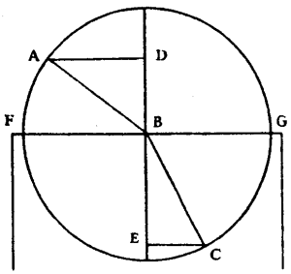
Theory

Slide 5
Theory
The Dutch polymath Christiaan Huygens describes the phenomena of refraction in his 1690 “Traité de la Lumière” (Treatise on Light), which details his wave theory of light, stating that, “The chief property of Refraction is that a ray of light, such as AB, being in the air, and falling obliquely upon the polished surface of a transparent body, such as FG, is broken at the point of incidence B, in such a way that with the straight line DBE which cuts the surface perpendicularly it makes an angle CBE less than ABD which it made with the same perpendicular when in the air.” ^{[1]}

Slide 6
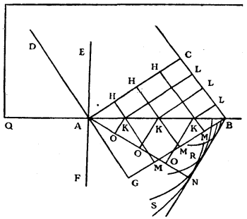
Theory
Huygens goes on to describe the practical aspects of refraction, saying, “Whence it is easy to recognize this chief property of refraction, namely that the Sine of the angle DAE has always the same ratio to the Sine of the angle NAF, whatever be the inclination of the ray DA: and that this ratio is the same as that of the velocity of the waves in the transparent substance which is towards AE to their velocity in the transparent substance towards AF.” ^{[2]}

Slide 7
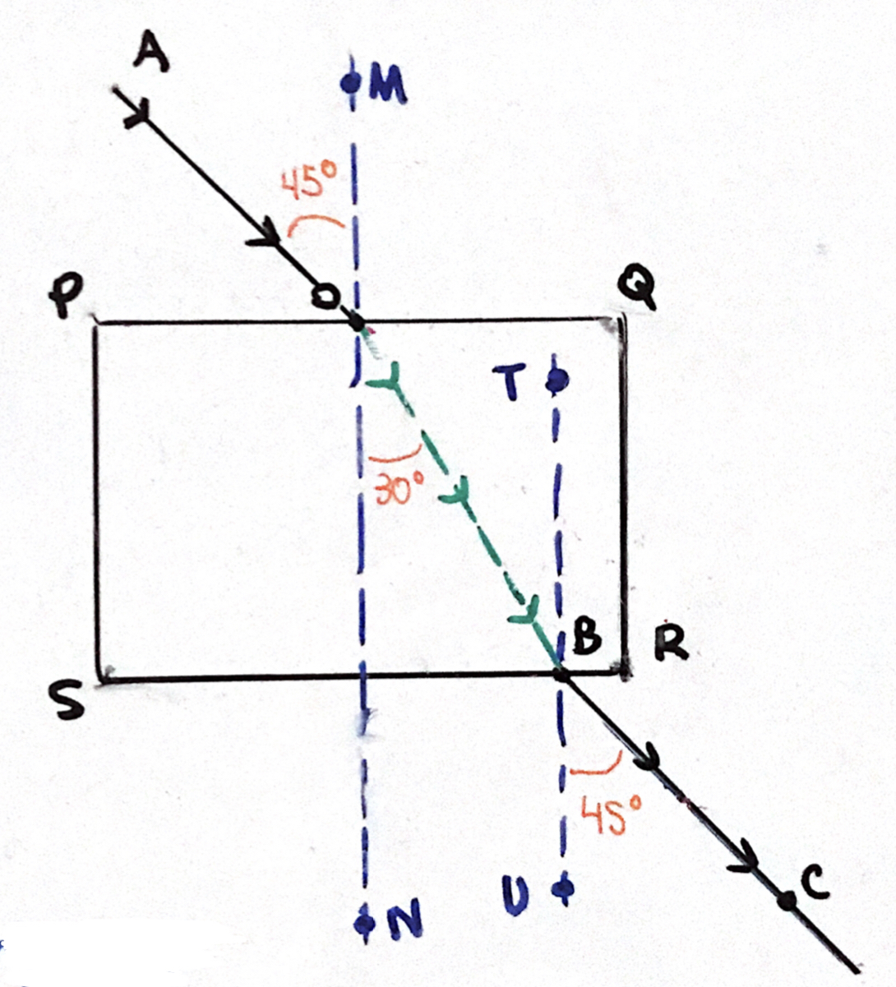
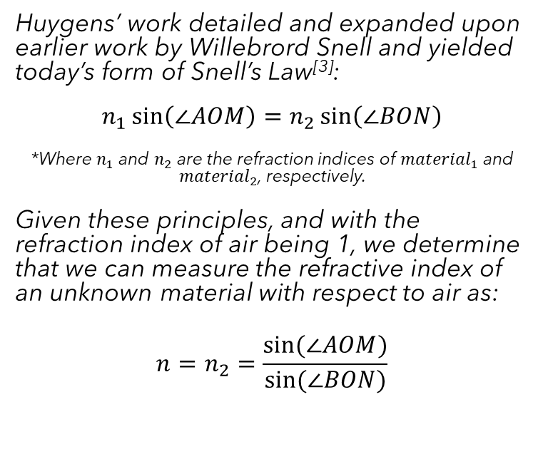
Theory
Huygens’ work detailed and expanded upon earlier work by Willebrord Snell and yielded today’s form of Snell’s Law^{[3]}:
$$n_{1}\sin\left(\text{∠}AOM\right)=n_{2}\sin\left(\text{∠}BON\right)$$
*Where $n_{1}$ and $n_{2}$ are the refraction indices of ${material}_{1}$ and ${material}_{2}$, respectively.
Given these principles, and with the refraction index of air being 1, we determine that we can measure the refractive index of an unknown material with respect to air as:
$$n=n_{2}=\frac{sin⁡(\text{∠}AOM)}{sin⁡(\text{∠}BON)}$$

Slide 8
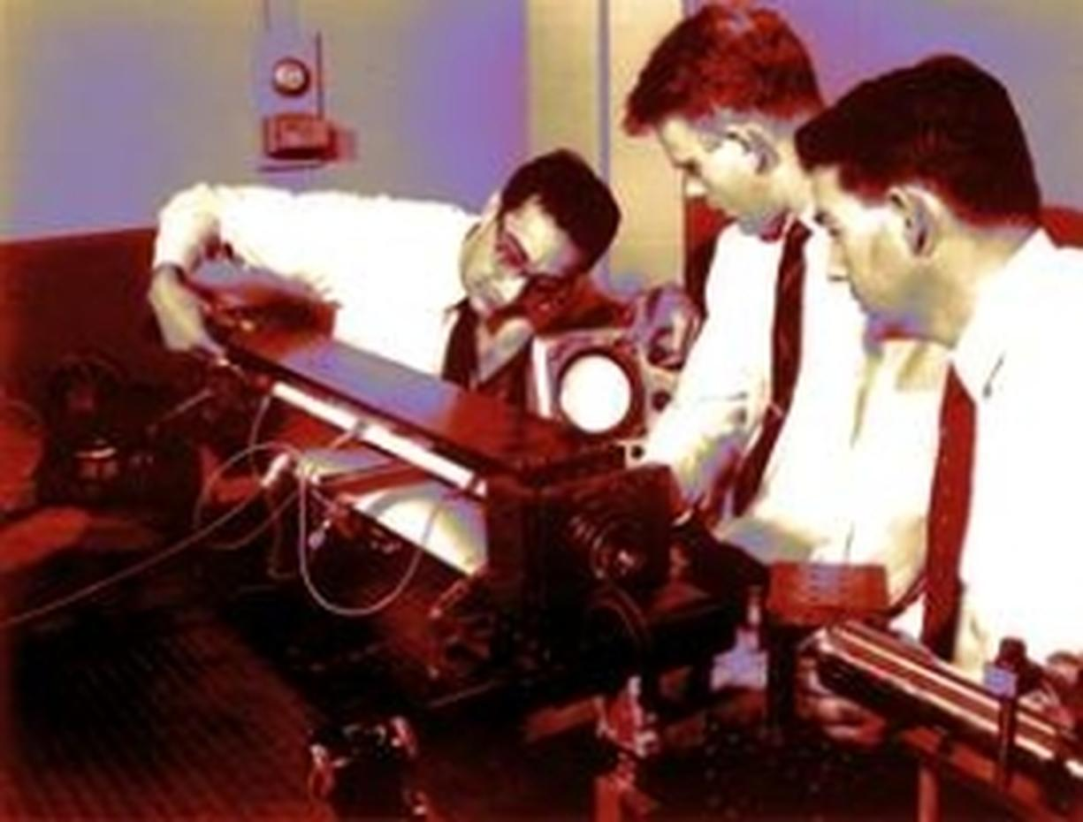
Methods

Slide 9
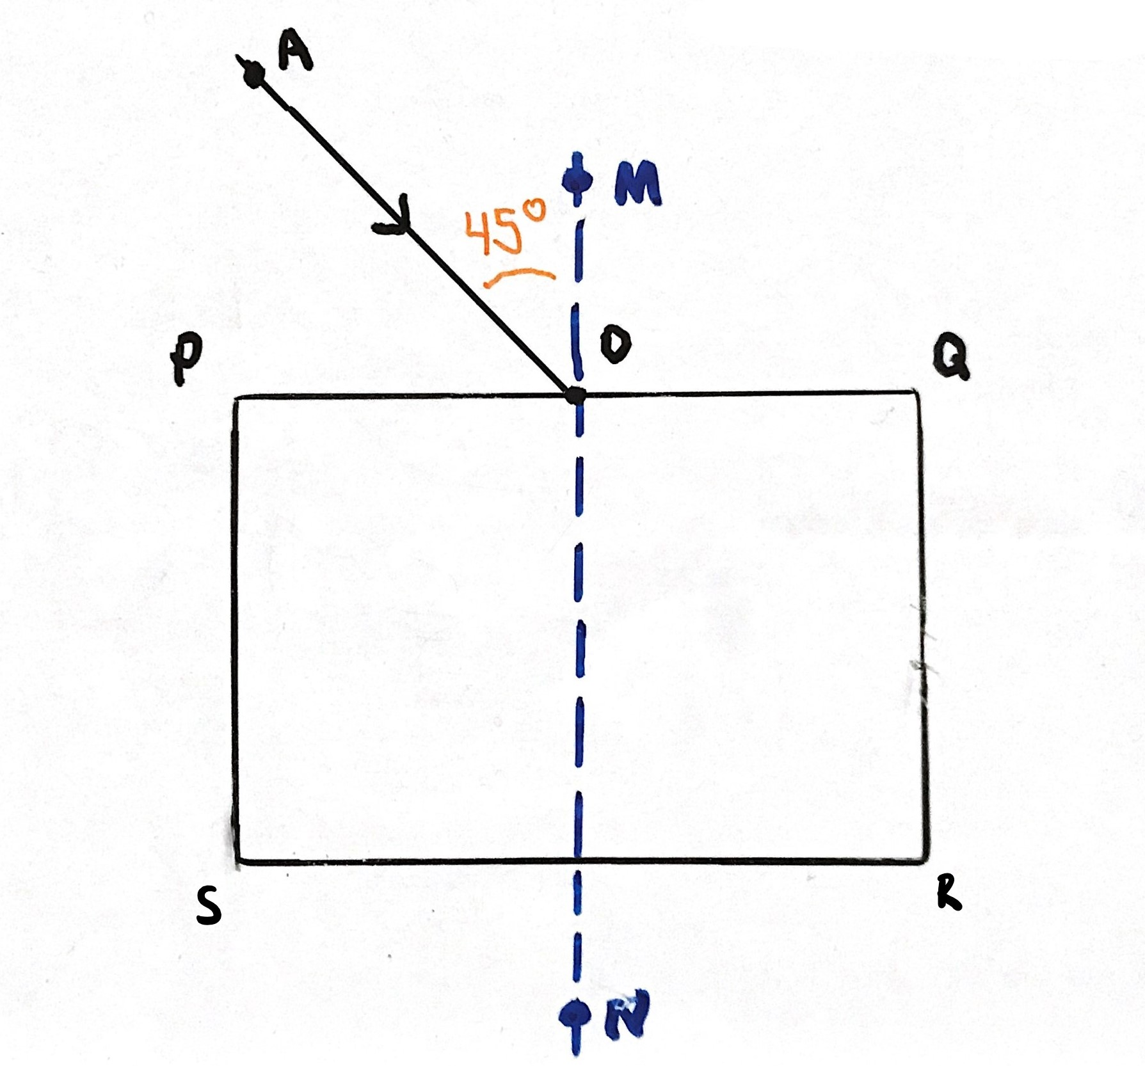
Methods – Setup
Outline the transparent block of unknown material.
Mark entry point O and place incident ray AO, noting angle of incidence (45º).
Place normal line at intersection of incident ray and block surface PQ.

Slide 10
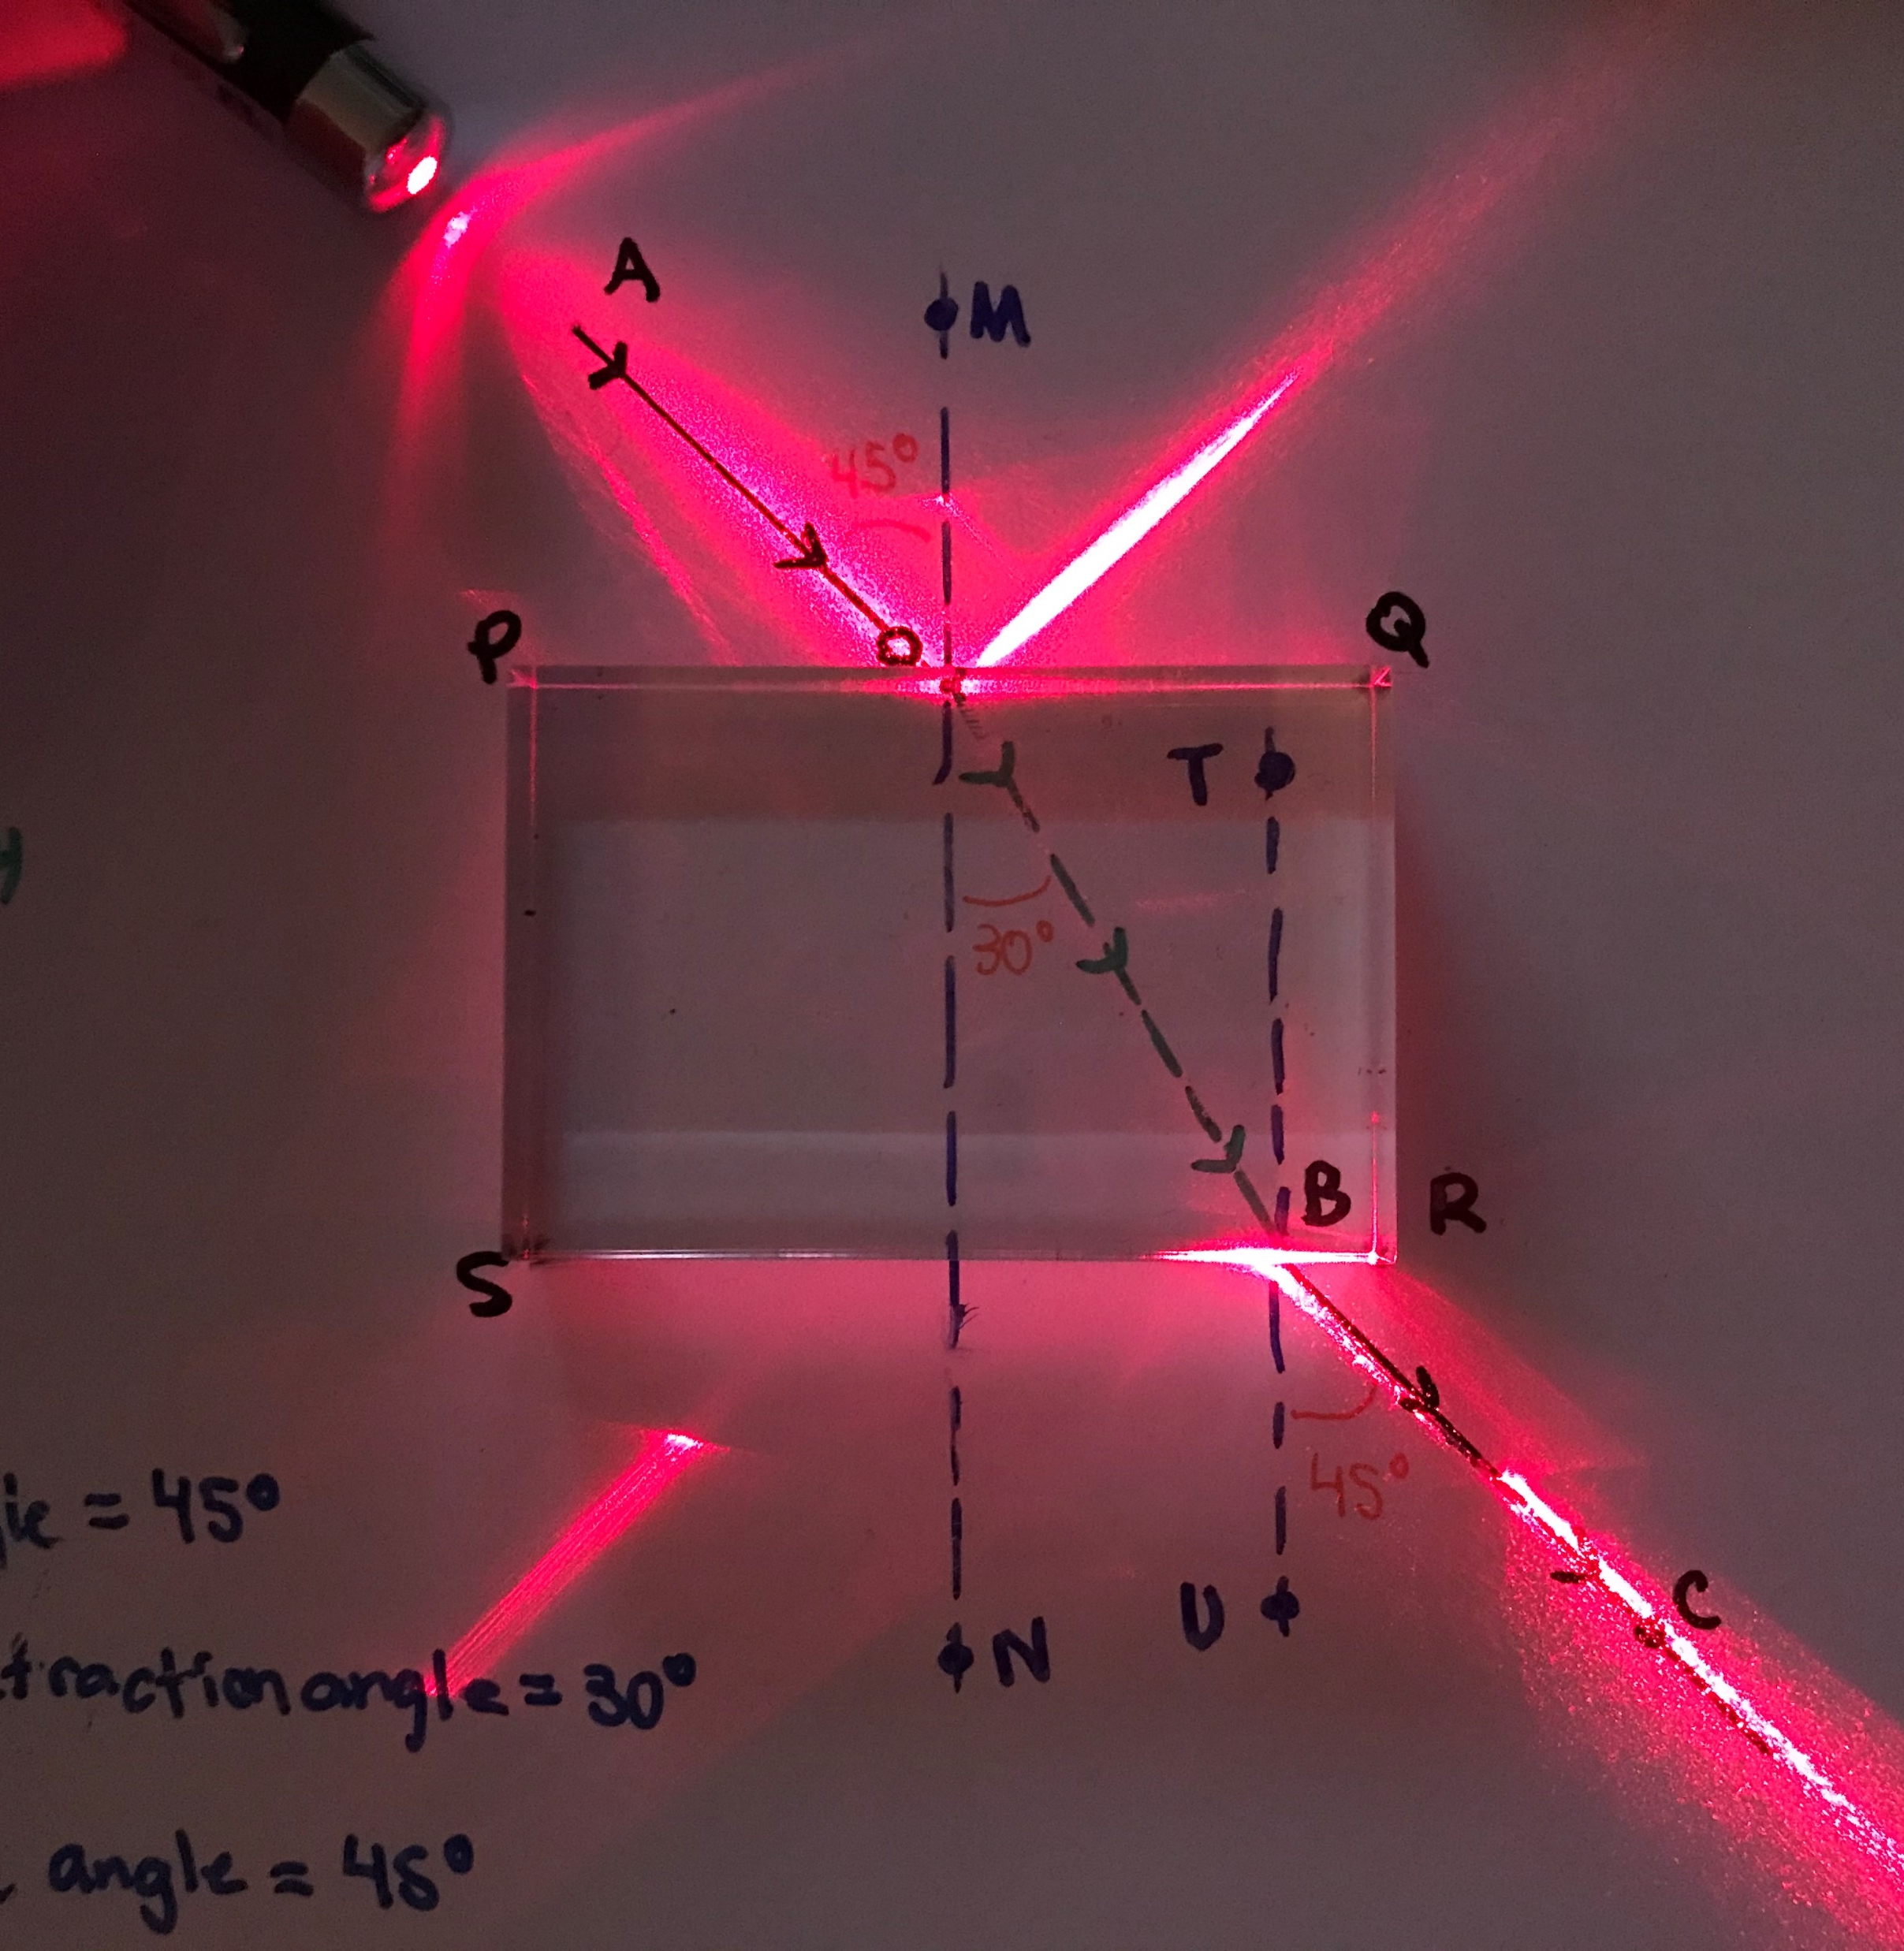
Methods – Execution
Place light source (laser: 650nm ± 10) aligned with incident ray AO.
Mark point of emergence B and point along emergent ray C.
Remove block trace emergent ray BC.
*Note: both the top ray pointing to the top-right corner, and the bottom ray pointing to the bottom-left corner are reflective rays of the incident and emergence rays, respectively. These rays are not involved in the calculations we performed.

Slide 11
Methods – Execution
Trace refraction ray OB from entry point O to emergence point B.
Measure and note refraction angle (block A: 30º; block B: 27º)

Slide 12
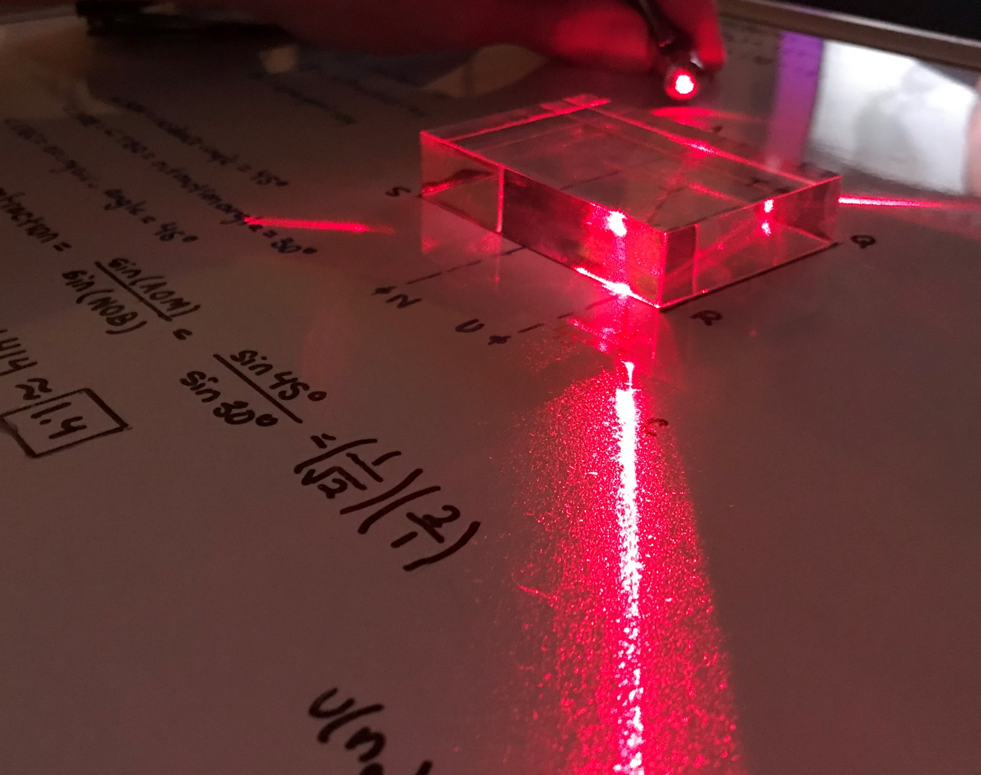
Results

Slide 13
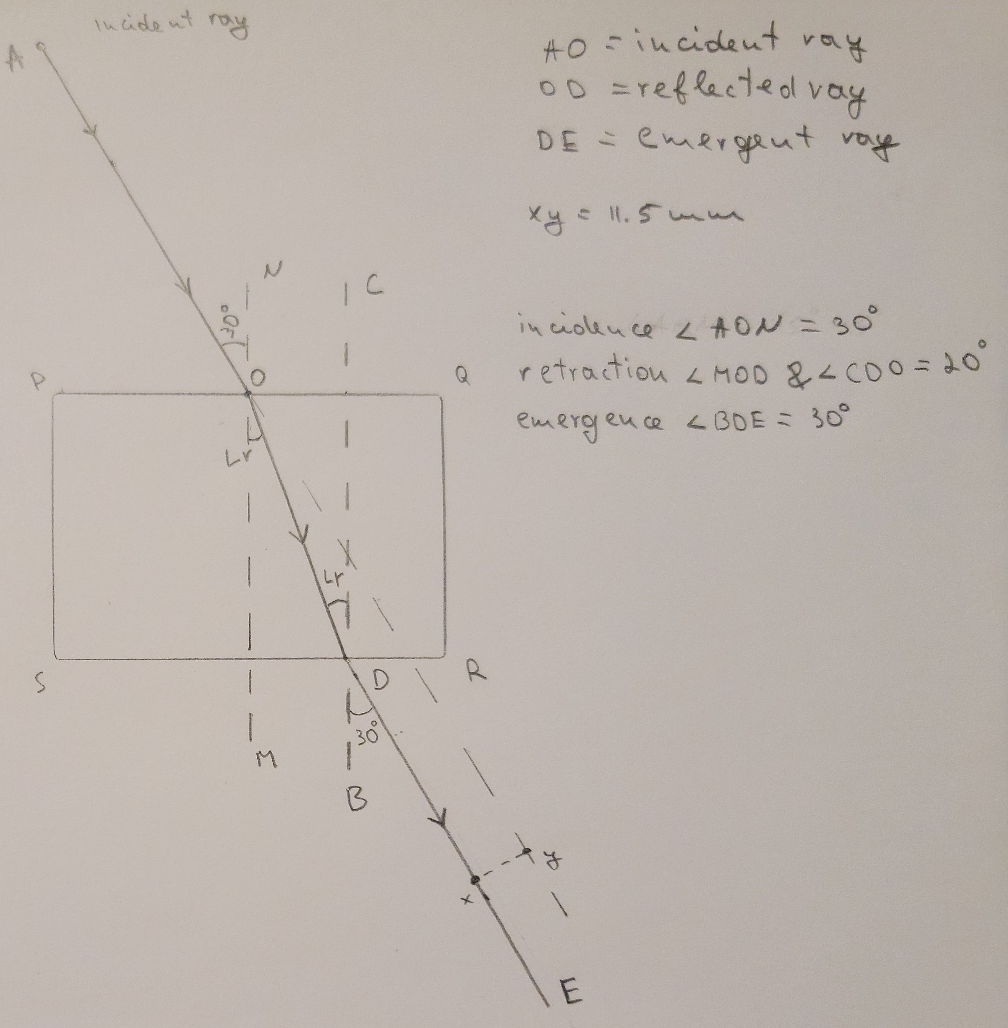
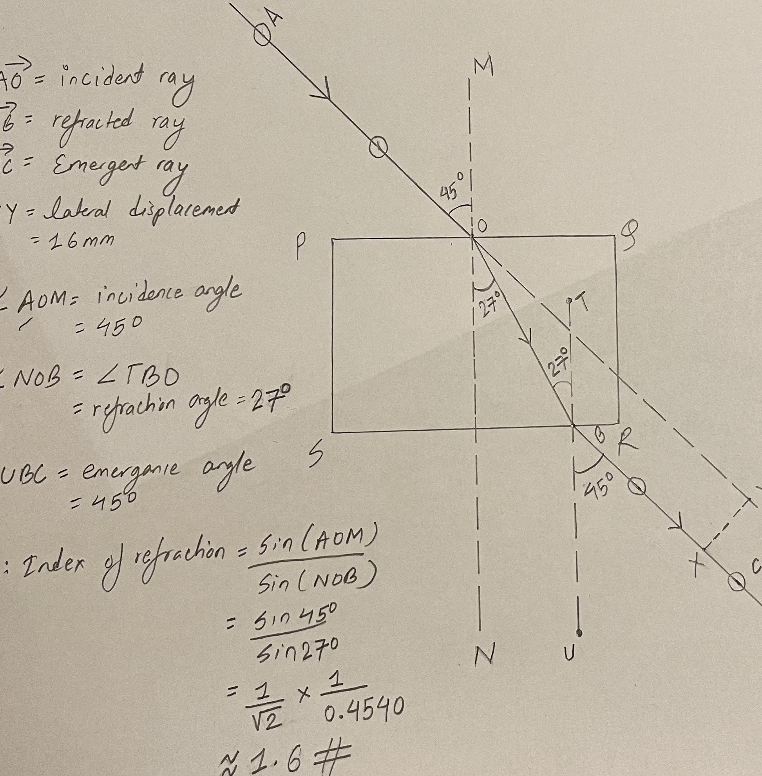
Results – Refraction Measurements
Experiments included incident angles of 30º and 45º.
For block A, an index was calculated to be 1.4 for both angles.
For block B, an index was calculated to be 1.6 for both angles.
 | Johnathan | Sandesh | Vasyl
Incident Angle 1 | 45 | 45 | 45
Refraction Angle 1 | 30 | 27 | 30
Emergent Angle 1 | 45 | 45 | 45
Incident Angle 1 | 30 | 30 | 30
Refraction Angle 1 | 20 | 26 | 20
Emergent Angle 1 | 30 | 30 | 30
Refraction Index | 1.4 | 1.6 | 1.4

Slide 14
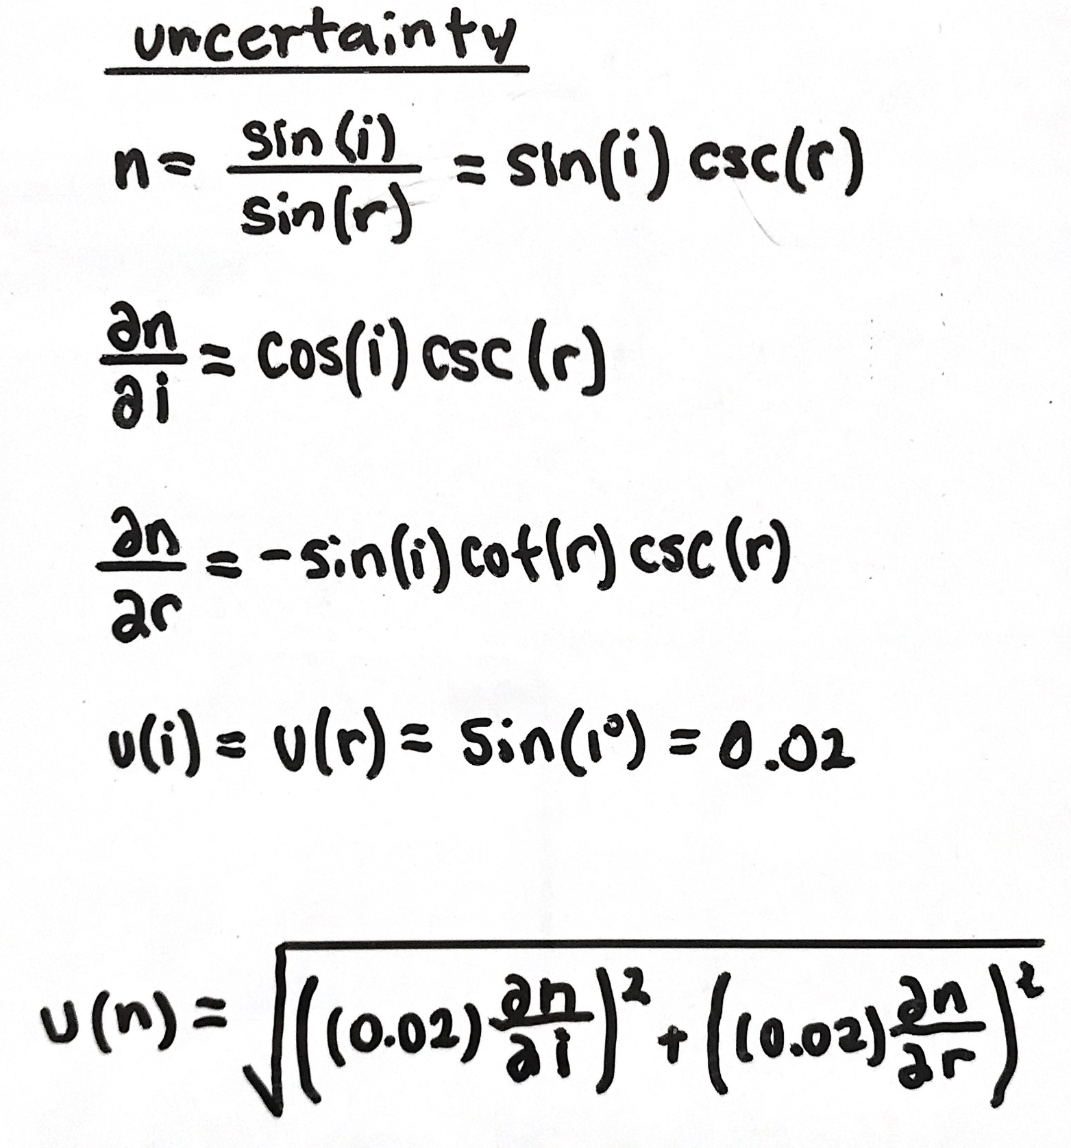
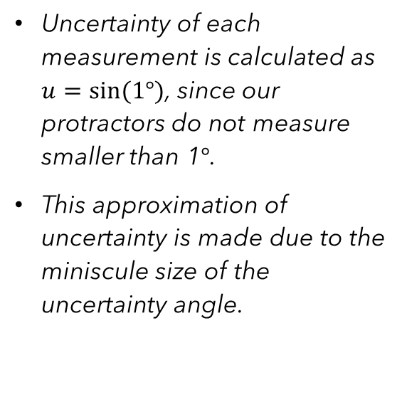
Results – Uncertainty Calculation
Uncertainty of each measurement is calculated as $u=sin⁡(1°)$, since our protractors do not measure smaller than 1$°$.
This approximation of uncertainty is made due to the miniscule size of the uncertainty angle.

Slide 15
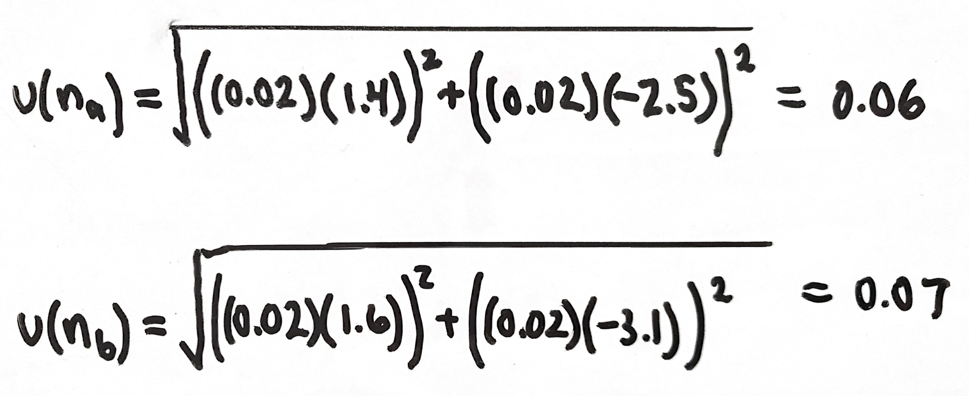
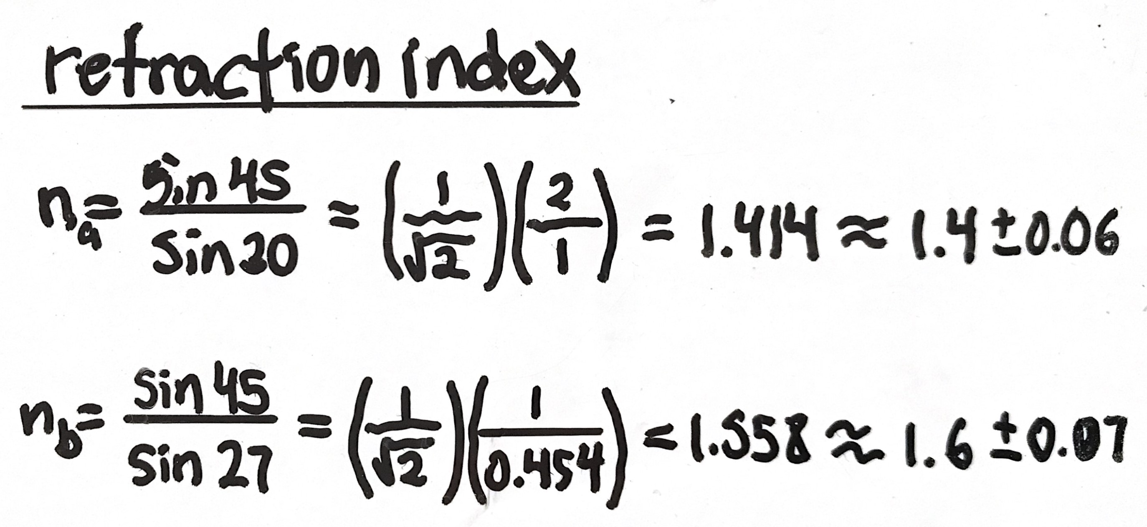
Results – Refractive Indices
Uncertainties are calculated using the aforementioned uncertainty calculation, with the respective incidence and refraction angles.
Refraction Indices are calculated using the principles stated by Huygens/Snell and given with their respective uncertainties.

Slide 16
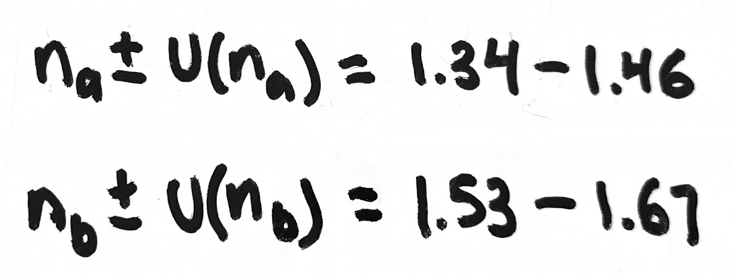
Results – Comparison
Ranges for refraction indices do not overlap.
Supports the conclusion that the two blocks have different physical compositions.

Slide 17

Reflections

Slide 18
Reflections
Main challenge – designing an experiment in a way that could be executed in discrete parts and later analyzed together.
Upon deciding to perform three identical experiments, work was easily split for each group member.
Analysis of identical experiments on different blocks from kits A and B led us to the conclusion of different physical compositions.
Analysis of identical experiments on identical blocks from two A kits further supported this conclusion and confirmed that the experiments were executed in an identical manner.

Slide 19
Bibliography
[1] – Huygens, C. (2005, January 18). Traité de la Lumière (Treatise on Light). The Gurenberg Project. https://www.gutenberg.org/files/14725/14725-h/14725-h.htm#Page_35.
[2] – Huygens, C. (2005, January 18). Traité de la Lumière (Treatise on Light). The Gurenberg Project. https://www.gutenberg.org/files/14725/14725-h/14725-h.htm#Page_38.
[3] – Gregersen, E. (2021, April 29). Snell's law. Encyclopedia Britannica. https://www.britannica.com/science/Snells-law.
[4] – Filmetrics, I. (2020). Refractive Index of SiO2, Fused Silica, Silica, Silicon Dioxide, Thermal Oxide, ThermalOxide. Refractive Index of SiO2, Fused Silica, Silica, Silicon Dioxide, Thermal Oxide, ThermalOxide for Thin Film Thickness Measurement. https://www.filmetrics.com/refractive-index-database/SiO2/Fused-Silica-Silica-Silicon-Dioxide-Thermal-Oxide-ThermalOxide.
[5] – Filmetrics, I. (2020). Refractive Index of Quartz. Refractive Index of Quartz for Thin Film Thickness Measurement. https://www.filmetrics.com/refractive-index-database/Quartz.

